Slide 1
D3.js / NVD3
By: Maiku

Slide 2
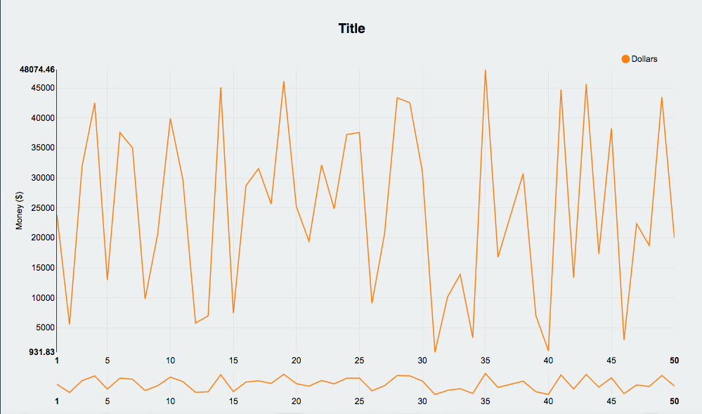
NVD3 Line Graph with Focus

Slide 3
Graph Options
Title can be edited by the user
The axis label can also be edited
The colour of the line can be changed with hexadecimal colors
https://color.adobe.com/create/color-wheel/
*Currently all changes can only be made by me, but with time it can be developed into a website where the engineers can easily make changes themselves.

Slide 4
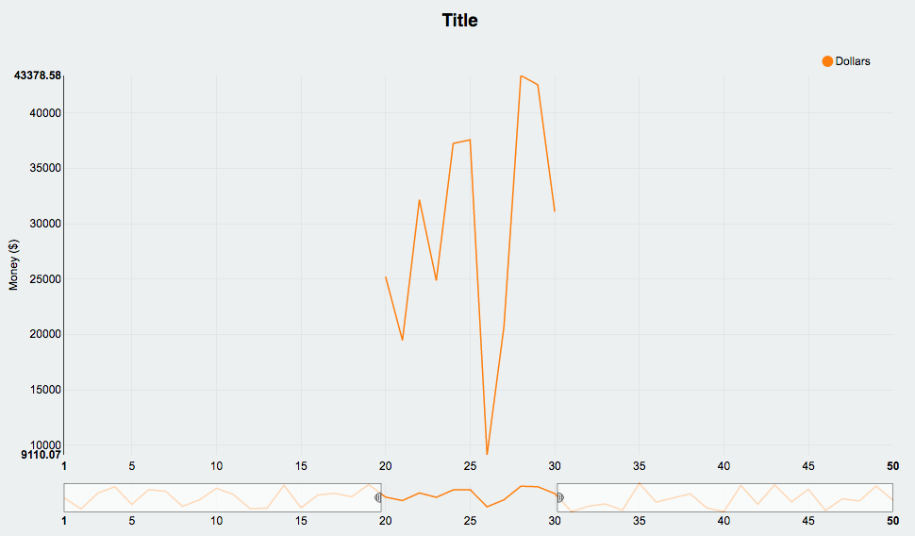
Chart Focus
Chart focus function is an interactive feature that allows users to focus on a specific part of the graph (which you can see on the picture on the right). This feature is most useful when the line graph contains a lot of data, but when you have graphs like the ones above, there’s not much use for these functions so they can be easily disabled by the users.

Slide 5
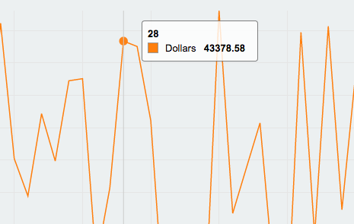
Another function NVD3 provides is when users hover over a point, it automatically shows the value for it. Furthermore, the gridline helps the users get to their value and if they are not seen as useful to the users, they can be disabled.

Slide 6
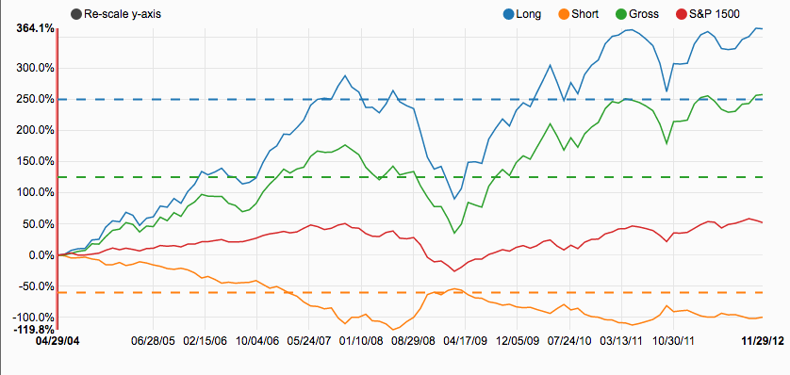
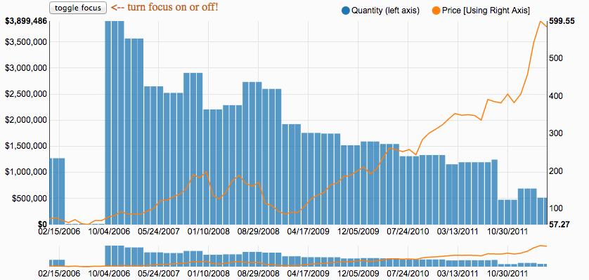
Types of graphs that can be made
Cumulative Line Chart
Line Plus Bar Chart

Slide 7
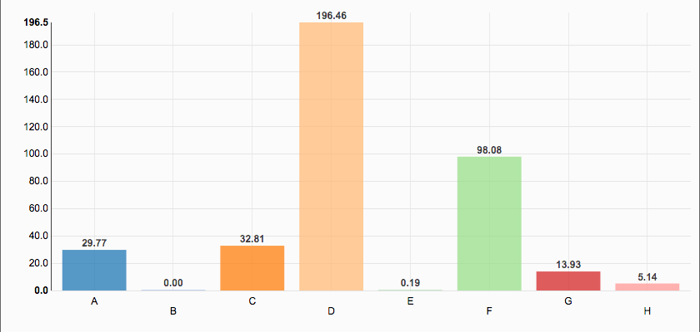
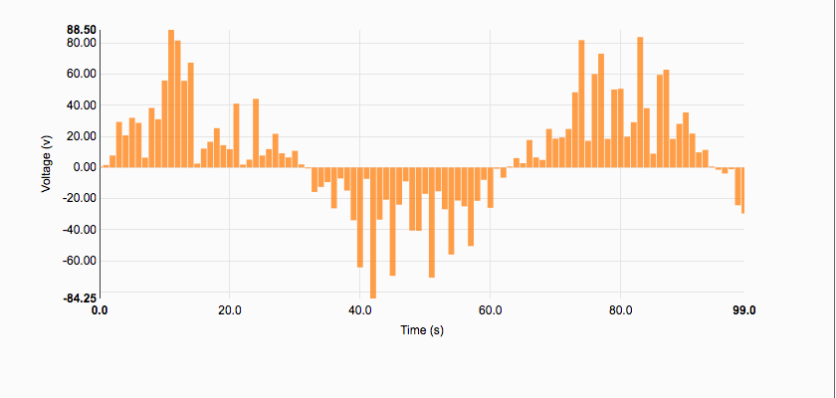
Discrete Bar Chart
Historical Bar Chart

Slide 8
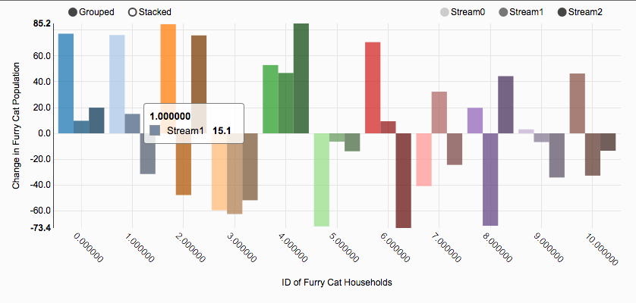
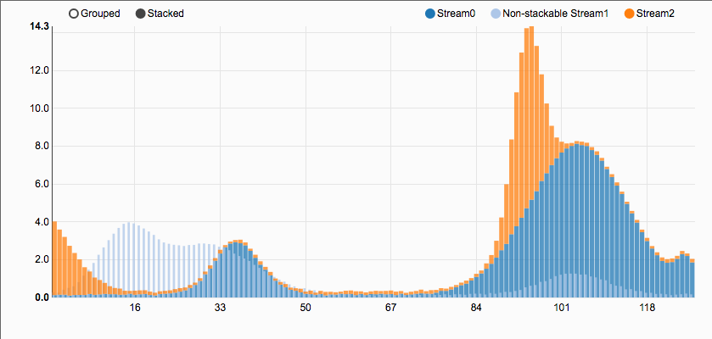
Multi Bar Chart
Multi Bar Chart 2

Slide 9
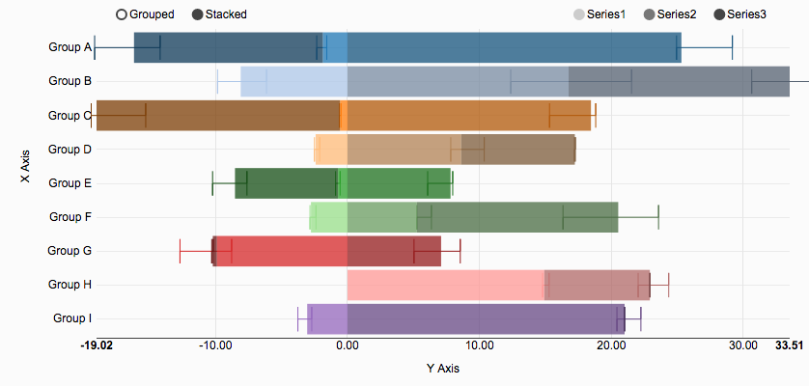
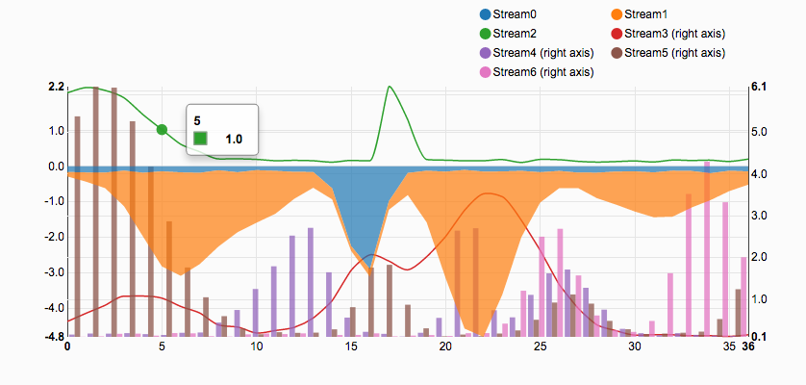
Multi Bar Horizontal Chart
Multi Chart

Slide 10
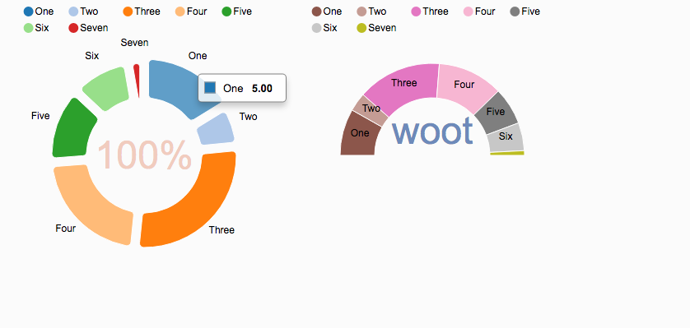
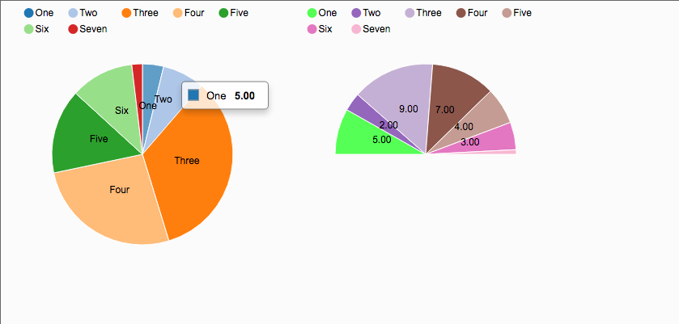
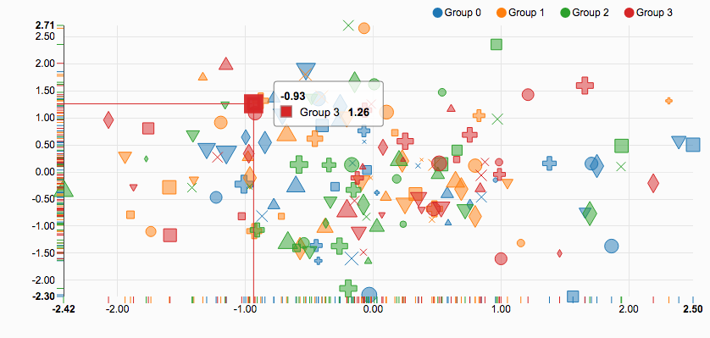
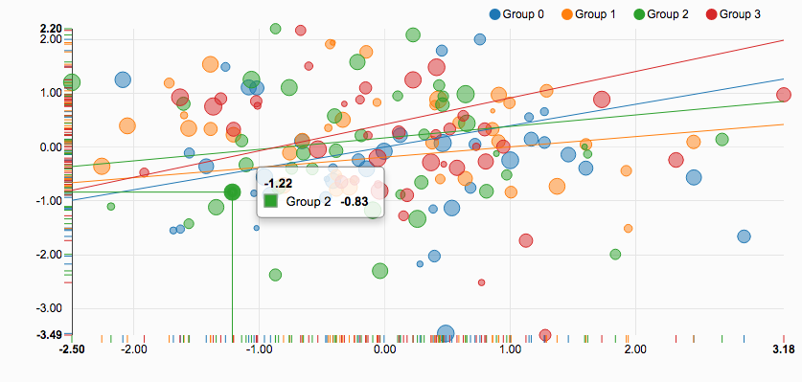
Donut Charts
Pie Charts
Scatter Chart
Scatter Plus Line Chart

Slide 11
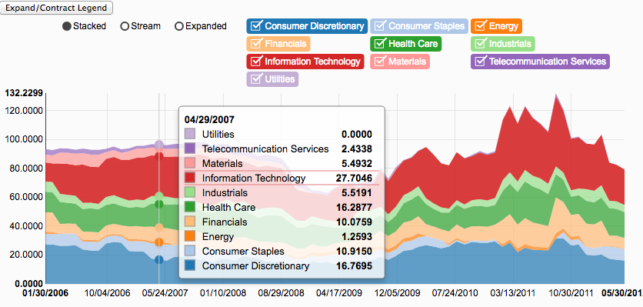
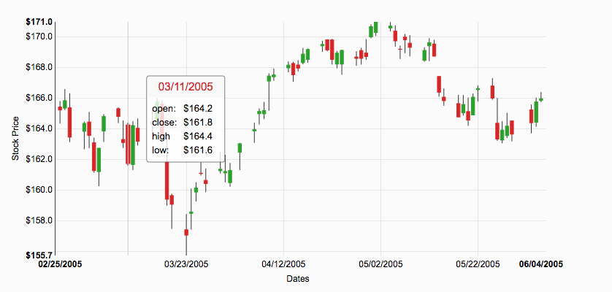
Stacked Area Chart
Candlestick Chart

Slide 12
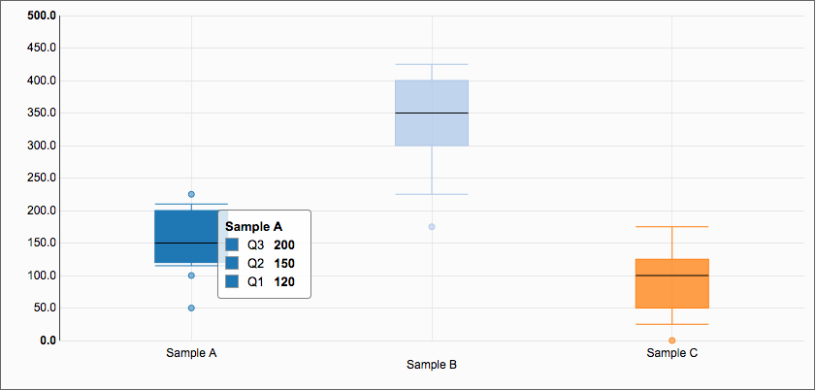
Box Plot

Slide 13
End

